Slide 1


IMAGE CLASSIFICATION APPLICATION
Guide:
Dr G P Bharathi
Presented by:
SHAGITHIYAN N (192324259)

Slide 2


Introduction
Image Classification: Identifies and categorizes objects in images.
Artificial Intelligence (AI): Enables computers to recognize and understand images.
Machine Learning (ML): Helps computers learn patterns from image data.
Deep Learning: Uses neural networks to classify images automatically.
Food Image Recognition: Identifies food items such as pizza, burgers, and dosa.
Automated Identification: Predicts food categories from uploaded images.
Applications: Used in food delivery, healthcare, agriculture, and food analysis.

Slide 3
ROLE OF PYTHON IN
IMAGE CLASSIFICATION
Simple Programming: Easy to learn, write, and understand.
Data Processing: Uses NumPy and Pandas to organize and process data.
Image Processing: Uses OpenCV to load and process food images.
Data Visualization: Uses Matplotlib to display images and graphs.
Model Development: Supports building and training image classification models.
Food Recognition: Helps identify food items such as pizza, burgers, and dosa.
Integration: Connects deep learning models with applications.

Slide 4
TENSORFLOW FOR DEEP LEARNING
Definition: An open-source deep learning framework developed by Google.
Model Development: Builds neural networks for image classification.
Model Training: Learns patterns from food image datasets.
Feature Detection: Identifies shapes, colors, and textures in images.
Image Classification: Predicts food categories from input images.
Model Evaluation: Measures the accuracy of predictions.
Example: Classifies food images as pizza, burger, or dosa.

Slide 5
PYTORCH FOR DEEP LEARNING
Definition: An open-source deep learning framework developed by Meta.
Neural Networks: Builds models for image classification.
Model Training: Learns patterns from food image datasets.
Flexibility: Allows developers to modify and experiment with models.
Image Recognition: Identifies food items from images.
Performance Testing: Evaluates model predictions and accuracy.
Example: Predicts whether an image contains pizza, burger, or dosa.

Slide 6
NOTEBOOK ENVIRONMENTS
Definition: Interactive platforms for writing and executing Python code.
Jupyter Notebook: Supports coding, testing, and data analysis.
Google Colab: Provides a cloud-based environment for model training.
Data Processing: Helps load and prepare food image datasets.
Model Training: Trains deep learning models using image data.
Testing: Checks model predictions using new images.
Visualization: Displays images, graphs, and accuracy results.
Debugging: Helps identify and correct coding errors.

Slide 7
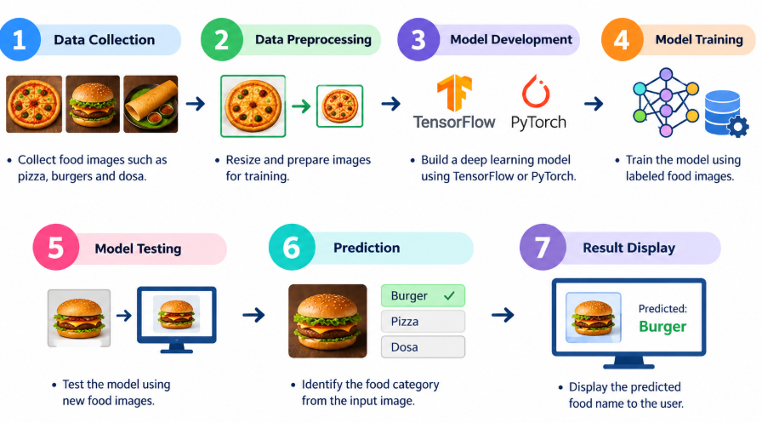
WORKING PROCESS OF
IMAGE CLASSIFICATION

Slide 8
Conclusion
Image Classification: Identifies food items automatically from images.
Python: Supports programming and data processing.
TensorFlow & PyTorch: Help develop and train deep learning models.
Jupyter Notebook: Supports testing and visualization.
Automation: Reduces manual effort and saves time.
Future Scope: Can be improved for food recognition and smart applications.

Slide 9
THANK YOU !

